Slide 1






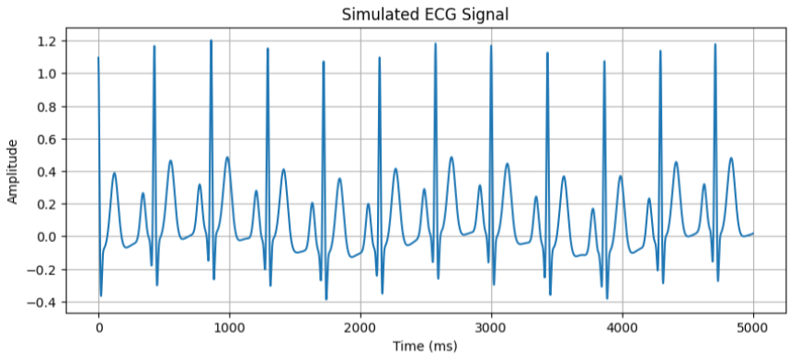
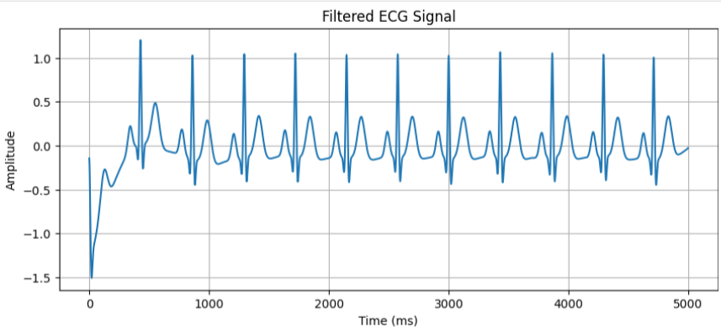
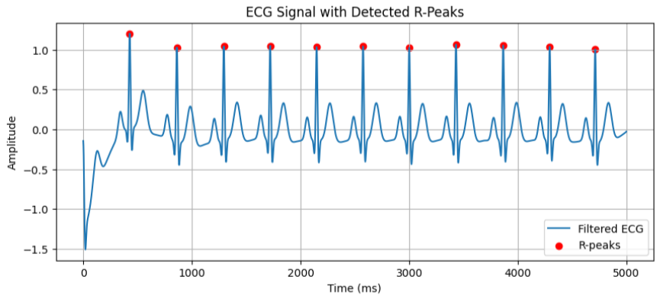
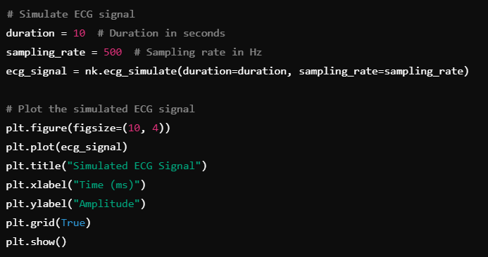
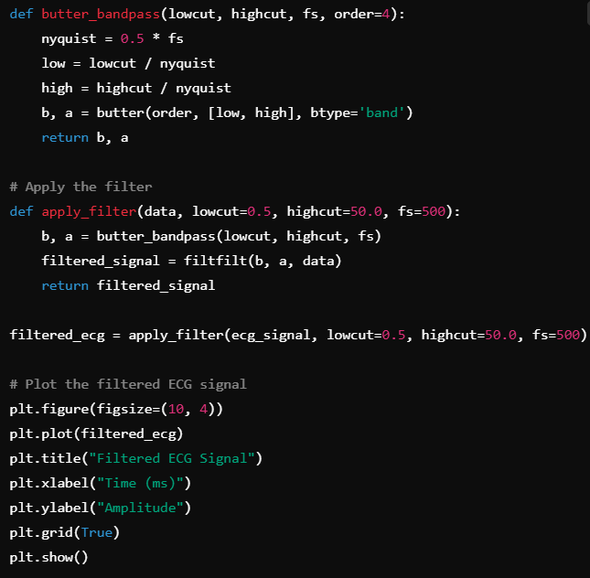
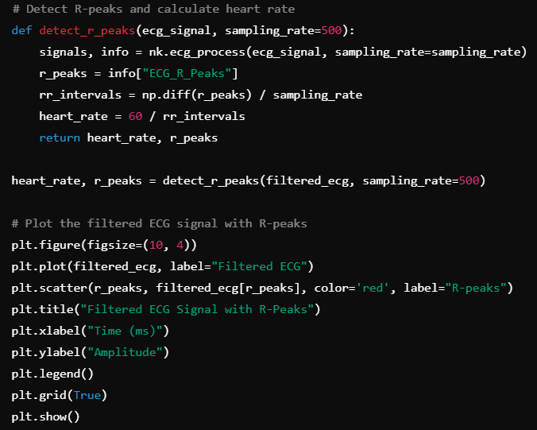
Real-Time ECG Signal Simulation and Analysis
Course: Biomedical Acquisition
Course Code: BMD351(FALL 2024 )
Under Supervision: Dr.Safa-Elaskary
TA: Karim El-Hawary
Prepared by: Youssef Essam
Faculty of Computer Science
Galala University
Abstract:
This project focuses on simulating, processing, and analyzing ECG signals to extract heart rate using Python libraries such as NeuroKit2 and Scipy. A 10-second ECG signal was simulated, filtered to remove noise, and processed to detect R-peaks, achieving an average heart rate of 72 bpm. Challenges like filter optimization and validation without real datasets were addressed effectively. The project demonstrates potential applications in real-time patient monitoring, wearable devices, and biomedical research, with future plans to integrate real-time hardware and analyze advanced metrics like HRV.
Methodology Split into three clear steps with small visualizations for each step:
Step 1: Signal Simulation\
Generate a 10-second ECG signal at 500 Hz sampling rate.
Visualization: Include a small plot of the simulated ECG signal.
Tool Used: NeuroKit2.
Step 2: Signal Filtering
Apply a Butterworth filter (0.5–50 Hz) to remove noise.
Visualization: Show a plot of the filtered ECG signal.
Tool Used: Scipy.
Step 3: R-Peak Detection and Heart Rate Analysis
Detect R-peaks using NeuroKit2 and calculate heart rate.
Visualization: Include a plot showing R-peaks overlaid on the filtered ECG signal.
Average Heart Rate: 70.04 bpm Heart Rate Values: [69.12442396 69.44444444 70.25761124 70.25761124 70.09345794 70.58823529 69.76744186 68.96551724 70.09345794 71.77033493]
Simulated ECG Signal.
Filtered ECG Signal.
Filtered ECG Signal with R-peaks
.

